Slide 1
LINUX shell
11/11/24

Slide 2
Why LINUX Shell?
Almost all servers run a LINUX variant
File-wrangling is often done through LINUX terminal
Often easier for pipelining

Slide 3
Shell Scripting vs. High-Level languages
Shell is for things that are easy to explain, but hard to program in other languages.
Also, for automating simple tasks that are done frequently
Limited scope, but can turn large Python functions into one-liners

Slide 4
Learning Objectives
Interactive Shell scripting
File control
Writing output to a file

Slide 5
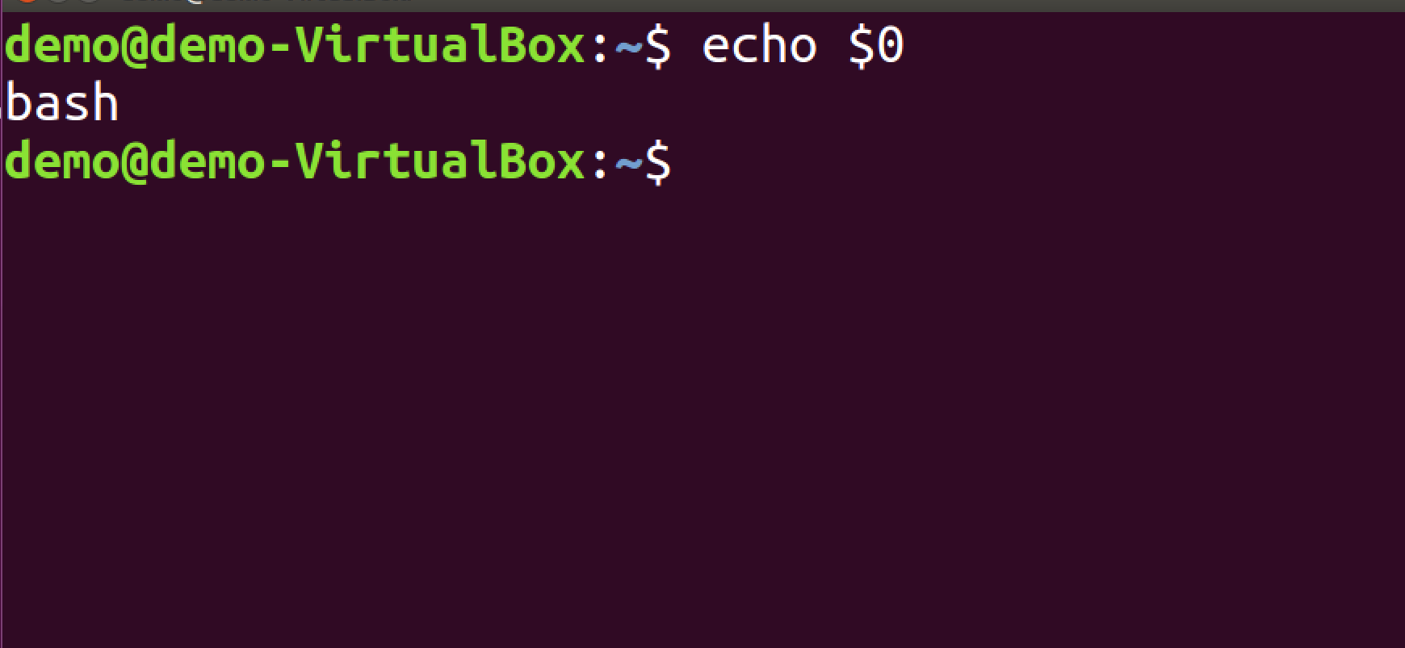

Using Shell
Linux/Unix users
Open terminal
PC users
Use the gitBash terminal

Slide 6
Shell Coding
Interactive through terminal
File & permission management
Browsing directories
Shell scripts
Automated routines
Pipelines linking programs
.sh
Today:
one-liners
Next 2 classes

Slide 7
Navigating a linux server
Fairly standard setup:
Root
Dev
Scratch (1,2…)
Home

Slide 8
Command Format
Command structure is formatted around spaces (like SQL) not parentheses (unlike Python)
Options (flags) denoted with dashes
e.g.
mv –i fold1/foo.txt fold2/bar.txt home/newFolder
(this moves foo and bar to home/newFolder and requires confirmation for overwrite)

Slide 9
Navigation Commands
cd = current directory
Used for entering a new folder
pwd = print working directory
Returns current folder

Slide 10
Navigation Commands
Current Directory (cd)
Passed alone—go to default directory (shortcut) is ~)
cd /home/fold1/…. go to absolute path
cd folder1/folder2/…. go to current-path +folder1/folder2
cd - go to last directory (cd - space - minus sign)
cd .. go back one level (cd - space – 2 dots)
Note: if using local PC-directories need double slashes (C:\\Users…) or single forward slash (C:/Users/…)

Slide 11
File/Folder Creation
touch file1 file2… creates empty files
Can specify directory (absolute or relative), but directory must already exist
Can specify file type (.txt, .py etc.) or leave as generic “file”
mkdir make a new directory
-p automatically make parent directories
this lets you specify a whole new folder tree
rm = remove (-p for recursive if non-empty directory)

Slide 12
Moving & Copying Files
mv loc1 loc2 = move from location 1 to location 2
If loc1 is a folder: moves loc1 + all contents into loc2
loc1/*: moves contents of loc1 (but not folder) into loc2
If loc1 and loc2 are files:
e.g. folder1\tmp1.txt folder2/tmp2.txt
Moves tmp1.txt into folder2 and changes name to tmp2.txt
How could I use mv to rename a file (without moving folders)?

Slide 13
Moving Files
mv flags: -i = asks for confirmation before overwrite
-b = backup (by adding ~ to name of old file)
-u = update (only overwrite if newer)
-n = no overwrite
-f = force (always overwrite)

Slide 14
Moving & Copying Files
cp loc1 loc2 = copy from location 1 to location 2
Similar syntax to mv (see last 2 slide for details) but diff. flags
No –b option for cp
cp -r = recursive (copy all contents of subfolders etc.) mv always does this (doesn’t need a flag)
cp -a = archive (preserve all ownership properties, timestamps etc.)

Slide 15
Practice: Allocate some files
Part 1: Create this structure:
Part 2: Create a file tmp.txt under BASH_447. Move it to the pract1 directory and rename it to pract1b.txt
pract1
pract1.txt
BASH_447
day_1
pract2

Slide 16

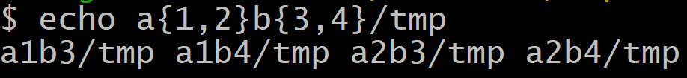
Brace Expansion
Returns all string-combinations of elements in braces
Cartesian-product: can stack multiple levels

Slide 17
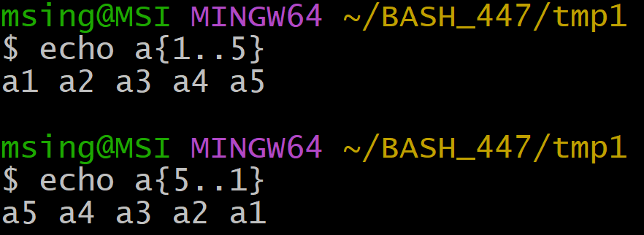
Brace Expansion
Can also do all numbers in range (implicit direction):

Slide 18
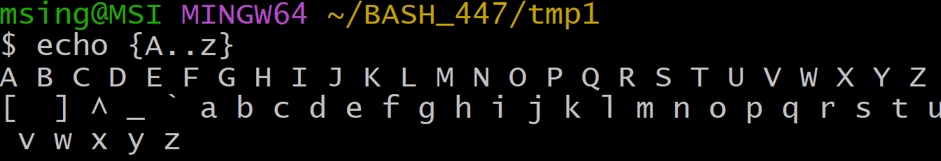
Brace Expansion
Similarly for letters but order is: upper-case, symbols, lower-case for ASCII characters

Slide 19
Practice Together: Nested directory tree
Create the following directory tree:
Year/Quarter/Company/{Company_earnings.txt, Company_costs.txt}
Year in 2020-2024
Quarter in Q1-Q4
Company in {Apple, Google}
We’ll only use 2 lines of code, no loops

Slide 20
Finding directory contents
ls loc1 = list contents of loc1 (if is folder)
Options:
-t = ordered by modification time
-S = order by size
-R = recursive
-d = only list directories (at the specified level)

Slide 21
Writing to a file
Write new contents (erasing old): > target.txt
Append onto new line: >> target.txt
Contents are in terms of a command’s outputs
So use echo abc>>tmp.txt to write “abc” to tmp

Slide 22
Practice
Write the full directory structure to a file folder_structure.txt within BASH_447
Write the directory structure for apple files only to apple_file.txt and similarly for google (do this separately)
Ditto but divide into halves: S1 contains Q1,Q2 and S2 has Q3,Q4
Hint: use wild-cards
*/*/apple/* selects all files of the format f1/f2/apple/f3…

Slide 23
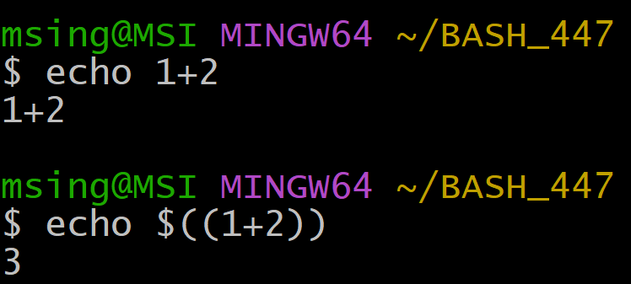
Variable Expansion
echo = print everything that follows
-e = interpret escape (e.g. \n = newline)
$ = variable expansion: return value stored in a variable, including temporary storage

Slide 24
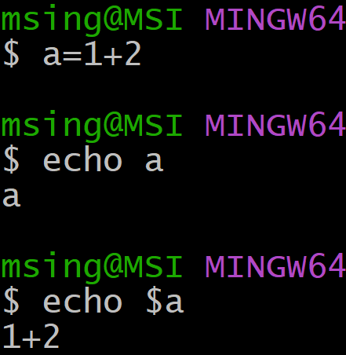
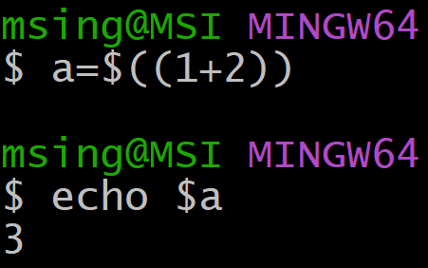
Variable Expansion
BASH has no intrinsic variable-type declaration, it has to be interpreted.

Slide 25
Practice Together
Let’s create a combined file containing apple and google directories separated by title-lines, i.e.
appleFiles
File1….
googleFiles
File2….

Slide 26
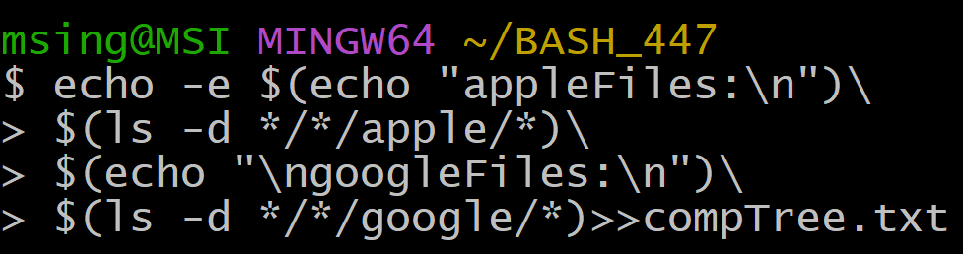
Practice Together

Slide 27
Learning Objectives
Interactive Shell scripting
File control
Writing output to a file

Slide 28
Fin

